Slide 1
CSE 512: Distributed and Parallel Database Systems
Lecture 1
Instructor: Mohamed Sarwat

Slide 2
Instructor Introduction

Slide 3
Class Demographics
Who among you is:
  PhD Student
  MS Student
  Undergraduate Student
  None of the Above

Slide 4
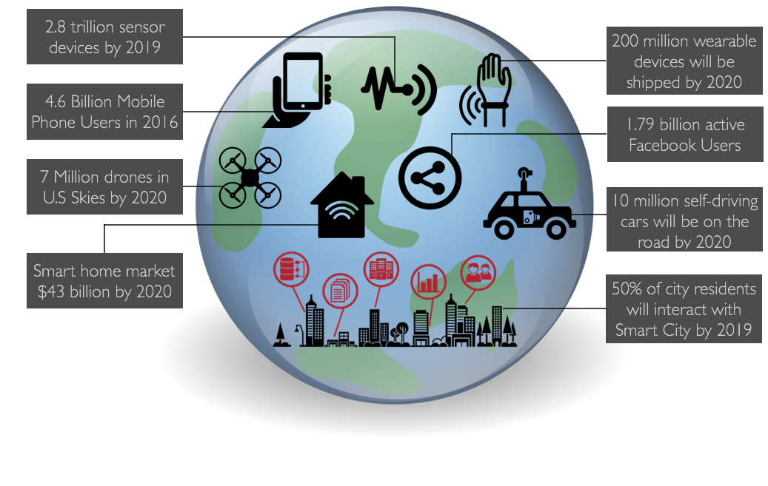
What it Data?

Slide 5
Data Processing
Save information in a safe place and retrieve it when necessary
Slicing /dicing the data to extract knowledge
Run statistical analysis method in order to understand the data at hand
Build models using the data to predict future events

Slide 6
About the Course
Distributed and Parallel Data Systems
Prerequisites:
  The course assumes familiarity with basic database concepts (covered in CSE 412)
  Recommended: Familiarity with Internals of database systems (covered in CSE 510)

Slide 8
Not attending the Session will make me fail the class ?
Absolutely
Maybe
No way

Slide 9
Grades
Assignments 25%
Group Project 35 %
Mid-term Exam 20%
Final 20 %

Slide 10
Your grade will be determined based on Absolute Grading Criteria ?
Absolutely
Maybe
No, I will be graded on a curve

Slide 11
Absolute Grading Criteria
A+: Grade >= 98%
A: 98% > Grade >= 95%
A-: 95% > Grade >= 90%
B+: 90% > Grade >= 86%
B: 86% > Grade >= 80%
B-: 80% > Grade >= 77%
C+: 77% > Grade >= 73%
C: 73% > Grade >= 70%
D: 70% > Grade >=60%
E: < 60%

Slide 12
Student Role
Actively participate in class and engage in class activities.
Read recommended papers and book chapters and be prepared to discuss it in class
Turn in all assignments (and project) on time.
Score >= 50 % on the midterm and final examination.
Score >= 50 % on each phase of the group project.

Slide 13
Class Participation
Reading Summary
In-class activities

Slide 14
Assignments
Five Total Assignments
Each is 5% of the total grade

Slide 15
Project
35% of the grade
Extend an existing Distributed/Parallel Data Platform (SparkSQL) to perform GeoSpatial operations
  Filter all taxi trips to only return trips for which the client is picked up in Dowtown Tempe
  Calculate the count of taxi trips in each neighborhood

Slide 16
Project
Phase 0: Group Formation and Platform Selection
Phase 1: Run and test existing system
Phase 2: First phase implementation
Phase 3: Second phase implementation
Phase 4: Detailed Report and Poster Presentation

Slide 17
Expected Workload
The class is demanding
A lot of programming
A lot of reading
A lot of in-class activities
One mid-term exam
One final examp
High Expectations

Slide 18
Handing Q/A to the instructor
No Emails.
Discussions Board

Slide 19
Academic Dishonesty
Students are expected to do their own assigned work
If it is determined that a student has engaged in any form of academic dishonesty, he or she may be given an "F" for the course and the incident will be reported to the dean

Slide 20
What happens If I do not submit one of the assignments?
I will receive Zero on this assignment
I will get an F grade for the class
I will receive an incomplete for the class

Slide 21
Welcome to CSE 512 ☺

